Slide 1


NEXT GEN EMPLOYABILITY PROGRAM
CREATING A FUTURE-READY WORKFORCE
Student Name :
SK RAMEEZ RAJA
College Name :
GOVERNMENT COLLEGE OF ENGINEERING & TEXTILE TECHNOLOGY,SERAMPORE
Student ID :
STU678caa17763371737271831

Slide 2
CAPSTONE PROJECT SHOWCASE
Project Title
FULL STACK WEB DEVELOPMENT WITH MERN(ZOMATO CLONE)
Abstract | Problem Statement | Project Overview | Proposed Solution | Technology Used | Modelling & Results | Conclusion | Q&A

Slide 3
Abstract
1
User-Centric Food Delivery Platform
2
Scalable Food Ordering Application
3
Modern Restaurant Management and Food Delivery
4
Comprehensive Food Discovery and Ordering Platform

Slide 4


Problem Statement
Title:
"Build a Full-Stack Restaurant Aggregator and Food Ordering Platform"
Objective:
To develop a feature-rich, scalable, and responsive web application using the MERN stack that replicates the functionality of Zomato. The platform should allow users to browse restaurants, view their menus, place orders, and manage their profiles, while providing admin functionalities for restaurant management.
Description:
With the growing demand for online food delivery and restaurant discovery platforms, creating a Zomato-like clone offers an opportunity to gain experience in full-stack development. The application should cater to two types of users: customers and admins.

Slide 5

Project Overview
Key Features:
User Authentication: Secure login and signup using JWT for session management.
Restaurant Listings: Browse restaurants categorized by cuisine, location, or popularity.
Restaurant Details: View restaurant menus, pricing, and detailed descriptions.
Order Management: Add items to the cart, review, and place orders.
Admin Panel: Manage restaurant data, including adding or updating menus.
Responsive UI: Built with React for dynamic and interactive pages.
Outcome:
This project showcases the ability to design and implement a full-stack application with modern web technologies, focusing on real-world usability, scalability, and maintainability.

Slide 6
Proposed Solution
A Zomato clone using MERN (MongoDB, Express.js, React.js, Node.js) would involve:
Backend: Node.js/Express.js for API endpoints handling restaurant data, user authentication, order management, and payment processing. MongoDB for storing restaurant details, user profiles, orders, and reviews.
Frontend: React.js for a dynamic, responsive user interface with components for restaurant listings, search, menus, cart, and user profiles.
Integration: Axios or Fetch for API calls, Redux or Context API for state management, and libraries like Mapbox or Google Maps API for location services.
Features:
Home Page: Display restaurants with search and category filtering.
Restaurant Details: Show menu items, reviews, and an "Add to Cart" feature.
Cart & Orders: Allow users to review their cart, place orders, and view past orders.
Deployment:
Host the backend on Render/Heroku and the frontend on Vercel.
Use GitHub Actions for CI/CD to ensure smooth deployment.

Slide 7
Technology used
Frontend:
React.js: For building dynamic and responsive user interfaces.
Vite: A fast development build tool for React.
React Router: For routing between pages (Home, Login, Restaurant Details, etc.).
Axios: For making HTTP requests to the backend.
Backend:
Node.js: JavaScript runtime for handling server-side operations.
Express.js: Framework for building RESTful APIs.
JWT (JSON Web Tokens): For secure user authentication and authorization.
Bcrypt.js: For password hashing to enhance security.
Database:
MongoDB: NoSQL database for storing users, restaurants, and menu data.
Mongoose: For schema modeling and interaction with the MongoDB database.
Development Tools:
Postman: For API testing.
VS Code: Code editor for development.
Environment:
Dotenv: For managing environment variables (e.g., database URI, JWT secret).

Slide 8
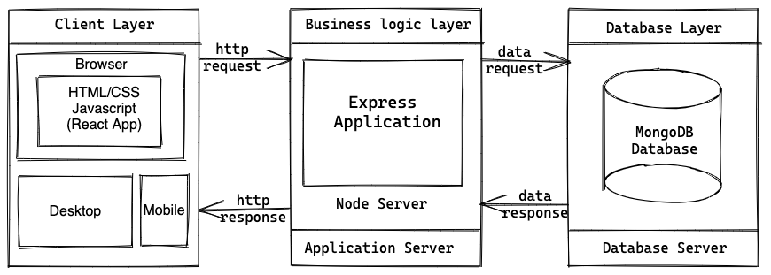
Modelling & Result

Slide 9
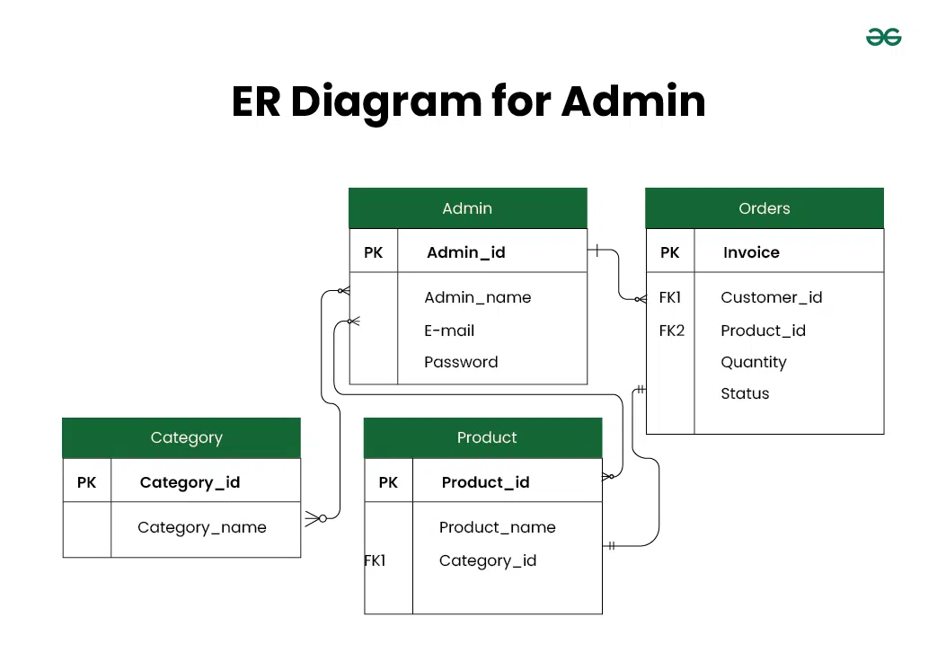
Modelling & Result

Slide 10
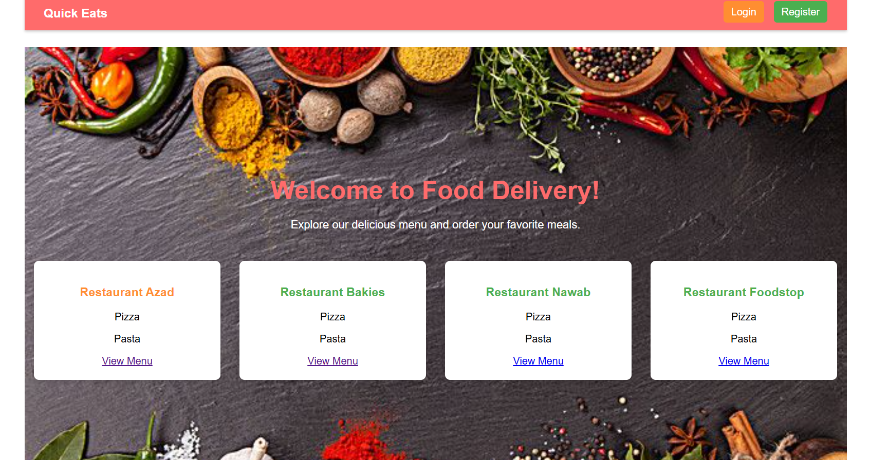
Modelling & Result

Slide 11

Conclusion
Scalability: The stack supports easy scaling for future features like real-time order tracking and payment integration.
Full-Stack Efficiency: Using JavaScript across the entire stack streamlines development, reduces context switching, and allows for code reuse.
Rich User Experience: React's dynamic rendering capabilities enable a seamless and engaging user interface, crucial for a platform focused on visual appeal and intuitive navigation.
Data Management and API Development: Express.js and Node.js provide a powerful backend for managing restaurant data, user authentication, order processing, and API development, ensuring secure and efficient data handling.
Feature-Rich Functionality: The MERN stack facilitates the implementation of essential features like location-based searches, real-time updates, secure payment gateways, and user review systems, creating a complete food delivery experience.
Modern Web Development: MERN aligns with modern web development practices, leveraging technologies that are widely adopted and supported by a strong community.
Cost Effectiveness: MERN stack's open source nature reduces development cost.

Slide 12


Notes:
Thank You !!

